Slide 1
Signatures of two-photon pulses from a quantum two-level system
Kevin A. Fischer1, Lukas Hanschke, JakobWierzbowski, Tobias Simmet, Constantin Dory,Jonathan J. Finley, Jelena Vuckovic and Kai Müller

Slide 2
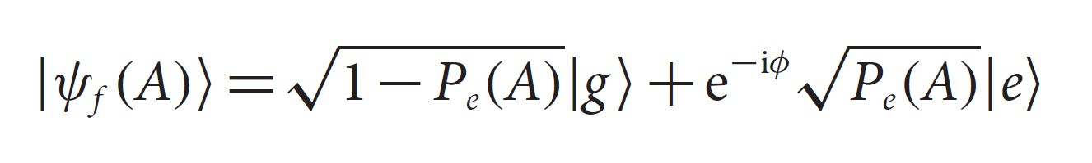
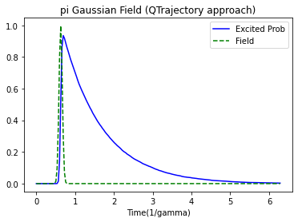
Stochastic decay due Spontaneous emissions.
A system in shown state, emits photon with probability prop. to Pe(A).
Single photon sources

Slide 3
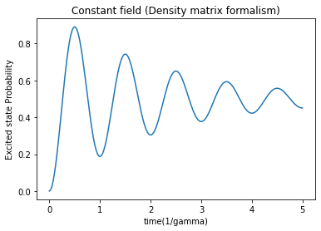
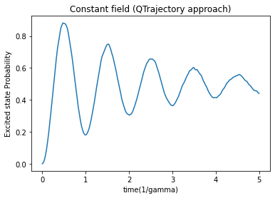
Quantum Trajectory Approach
Trajectory : a possible path that can be taken by a single realization of quantum system.
Many such trajectories averaged out to give approximate results.

Slide 4
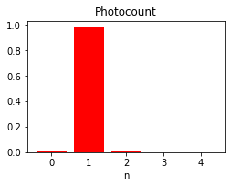
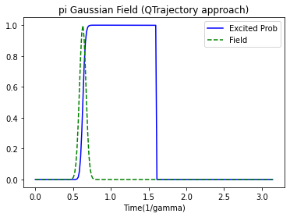
Two-level system under pi Gaussian pulse
FWHM = tau/10 = 1/(10*gamma)
E_n = 1.0098, (E_n>1)
Re-excitations!!

Slide 5
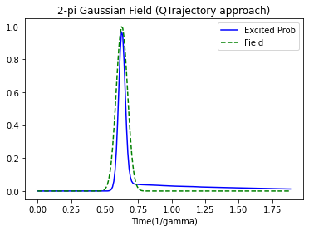
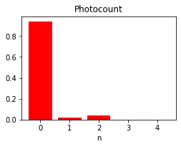
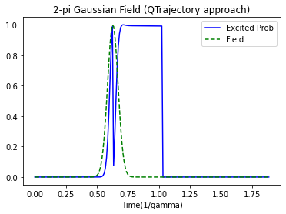
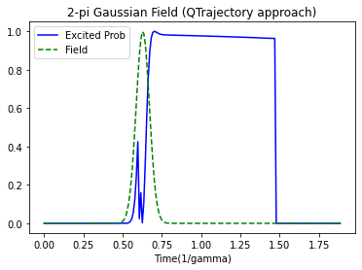
Re-excitations under 2-pi Gaussian pulse
FWHM = tau/10 = 1/(10*gamma)
E_n = 0.0991
P_2 > P_1 !!

Slide 6
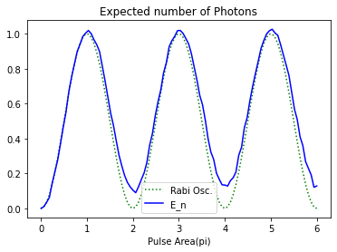
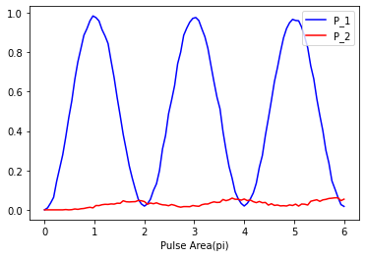
E_n and Photocounts (P_1, P_2) Vs Pulse area

Slide 7
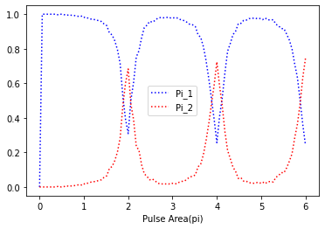
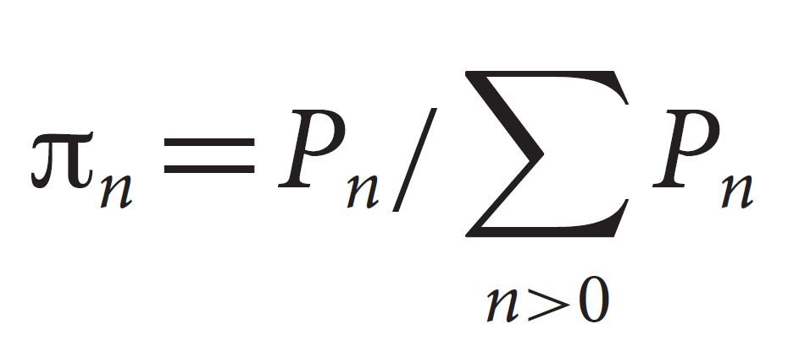
Photon number Purity Vs Pulse area

Slide 8
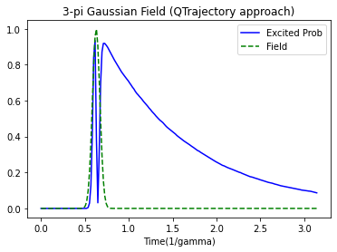
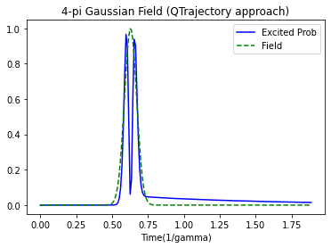
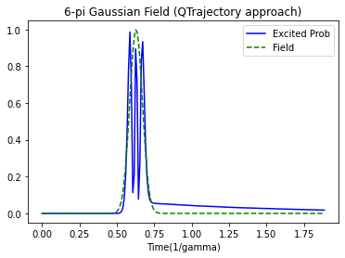
n-pi Gaussian pulses
FWHM = tau/10 = 1/(10*gamma)

Slide 9
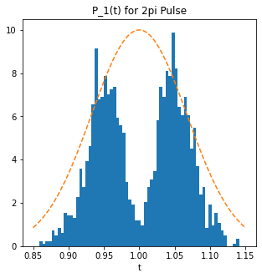
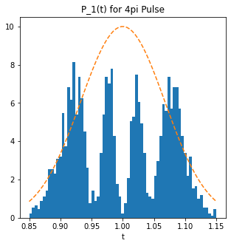
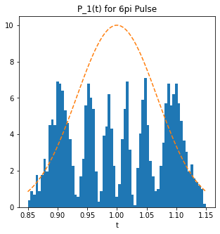
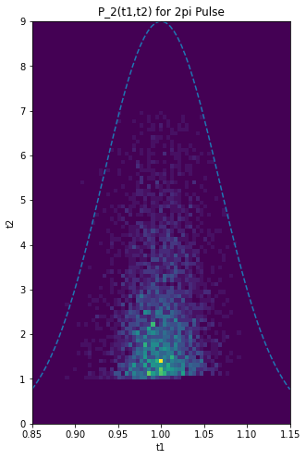
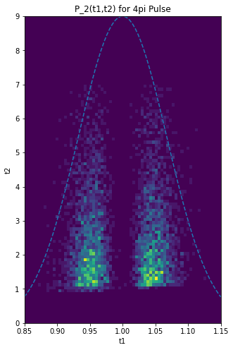
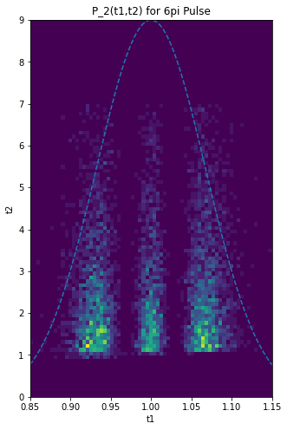
P_1(t)
P_2(t1,t2)

Slide 10
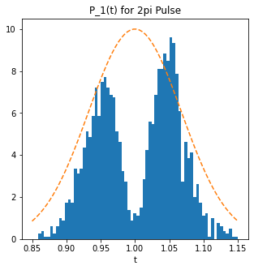
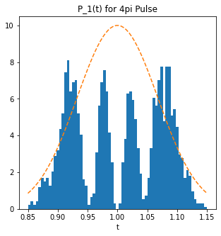
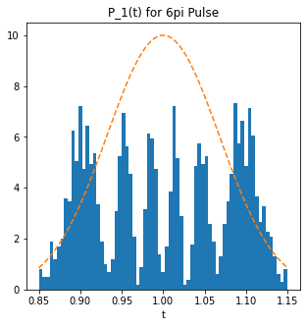
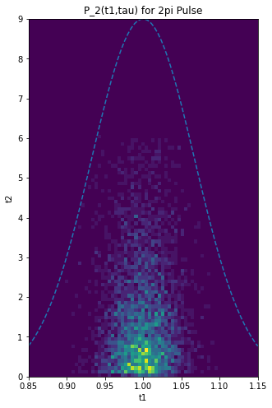
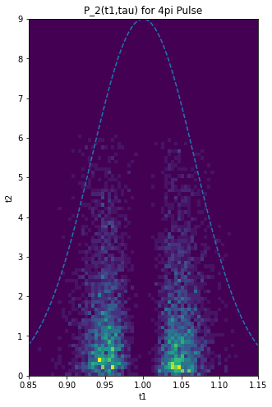
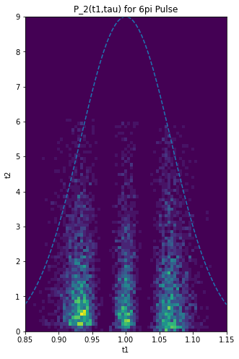
P_1(t)
2pi
4pi
6pi
P_2(t1,tau)

Slide 11
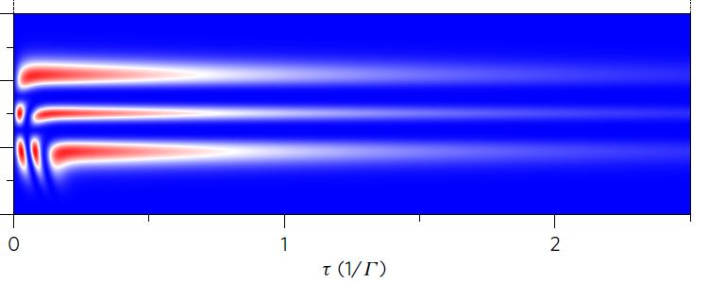
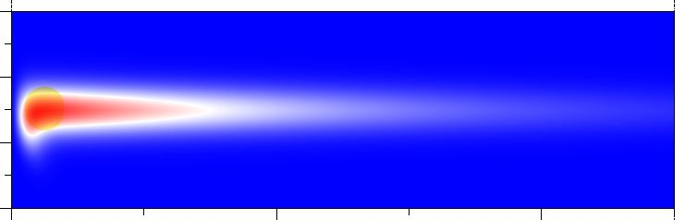
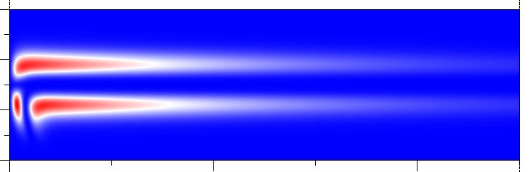
(simulating 10’s of millions of trajectories) “From Reference [1]”
2pi
4pi
6pi

Slide 12
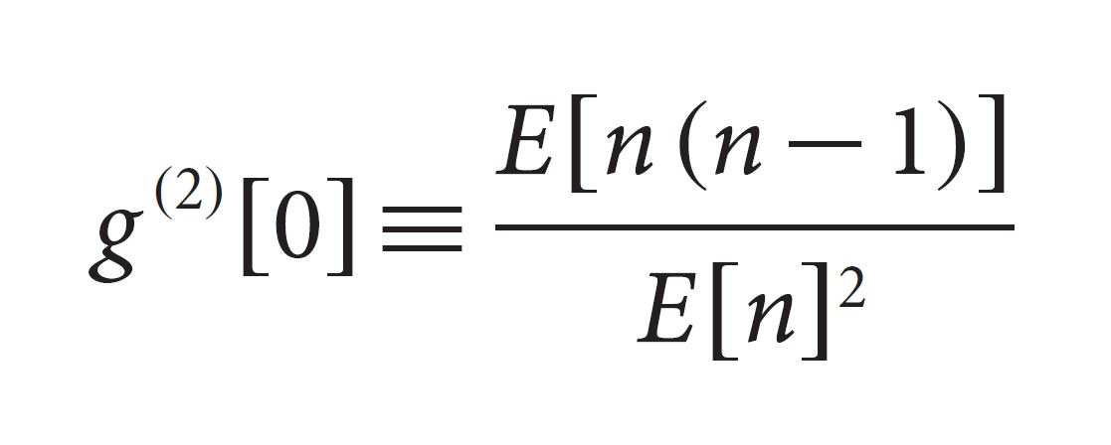
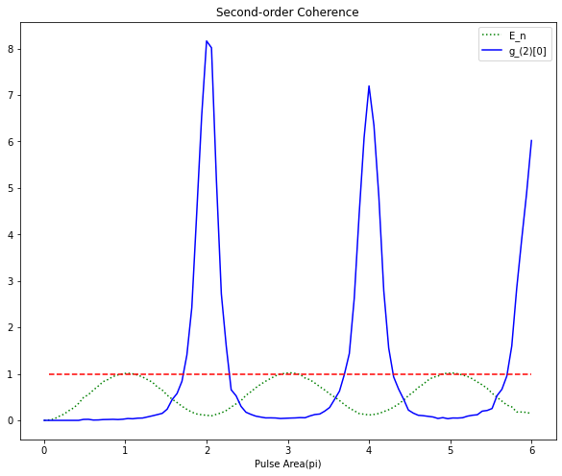

Looking for Signatures of two photon pulse in $g^{(2)}[0]$
Super-poissonian statistics for even-pi laser pulses.

Slide 13
References
Fischer, K., Hanschke, L., Wierzbowski, J. et al. Signatures of two-photon pulses from a quantum two-level system. Nature Phys 13, 649–654 (2017).
Johansson, J. R., Nation, P. D. & Nori, F. QuTiP 2: a Python framework for the dynamics of open quantum systems. Comput. Phys. Commun. 184, 1234-1240 (2013).
Fox, Mark. Quantum Optics: an Introduction. Oxford University Press, (2013).
http://qutip.org/docs/latest/guide/dynamics/dynamics-monte.html

